Slide 1
HRMG200
Human Resource Management: Staffing and Employee Engagement
Week One

Slide 2


Slide 3
Unit Introduction
Unit Outline
  Weeks of Study
  Assessments
  Academic Integrity
  Textbook

Slide 4
Objectives
Define the purposes and scope of human resource management (HRM) in Australia
Trace the development of HRM in Australia (and the Asia Pacific region), including its influences, issues and theories
Explain the concept of strategic human resource management (SHRM)
Understand the relationship between SHRM, business strategies and HRM functions

Slide 5
Objectives
Discuss the links between SHRM and organisational strategy, structure, culture and policy
Describe the principal roles, functions and outcomes of Australian HRM professionals
Define the professional and ethical principles which guide HRM

Slide 6
Introduction
All organisations rely on the availability and effectiveness of three kinds of resources: finances, technology and people.
The human resource (HR) is almost always the key ingredient for organisational success.
HR is the most unpredictable and often the largest ongoing cost factor, and may also be regarded as the most valuable asset in any organisation.
Both the nature of work and workplaces are currently transforming.

Slide 7
What is HRM?
Human Resource Management (HRM) is the policies, practices and systems that influence employees’ behaviour, attitudes, relationships and performance in an organisation

Slide 8
Stages in HRM Development
Welfare and administration (1900–1940s)
Welfare, administration, staffing and training (1940s–mid-1970s)
HRM and SHRM (mid-1970s–late 1990s)
SHRM into the future (2000 onwards)

Slide 9
Differences – PM & HRM

Slide 10
SHRM in the Future
Issues impacting SHRM:
  globalisation
  new technology
  changes in the nature of work and jobs.
HR professionals are perceived to add value to four key stakeholders, namely:
  employees
  line managers
  key customers
  investors.

Slide 11
Changing Employment Contract
The employment relationship comprises a set of overlapping contracts: the legal contract, the social contract and the psychological contract.
  Legal: terms and conditions of work
  Social: ‘the mutual expectations and obligations that employers, employees and society at large have for work and employment relationships’

Slide 12
Changing Employment Contract
Psychological: ‘reciprocal expectations of individual employees and their individual managers ... includes the whole pattern of rights, privileges and obligations between employees and their organisations … beliefs about fairness, trust and the delivery of worthwhile employment relationships’

Slide 13
Evolving Concepts and Models
Harvard model
Unitarist or pluralist
‘Soft’ or ‘hard’ HRM
HRM and industrial relations (IR)

Slide 14
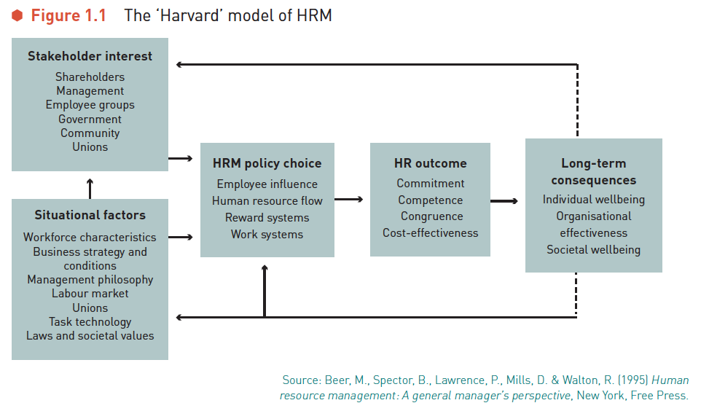
Harvard Model of HRM

Slide 15
Unitarism and Pluralism
Unitarist assumes:
  common interests between employers and employees
  commitment by both parties.
Pluralist assumes:
  inevitable conflicts of interest
  negotiation and resolution to achieve common goals.

Slide 16
Hard and Soft HRM
‘Hard’ HRM focuses on:
  strategic, managerial issues
  effective utilisation of HR towards broad goals and objectives.
‘Soft’ HRM focuses on:
  involvement of employees through consultation, empowerment, commitment and communication.

Slide 17
Business Strategy and HRM
Accommodative: HR strategies follow organisational strategies.
Interactive: HRM contributes and reacts to overall strategies.
Fully integrated: total involvement in overall strategic process in both formal and informal interactions.

Slide 18
Strategic HRM
Strategic human resource management (SHRM) emphasises the need for HR plans and strategies to be formulated within the context of overall organisational strategies and objectives, and to be responsive to the changing nature of the organisation’s external environment.

Slide 19
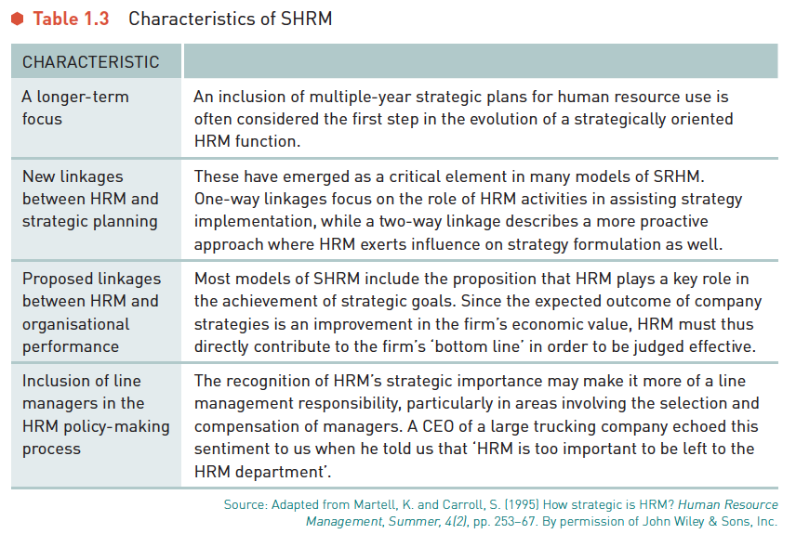
Characteristics of Strategic HRM

Slide 20
Criticisms of Strategic HRM
SHRM is certainly concerned primarily with contributing to the ‘bottom line’ success of organisations.
Ethical questions are raised about its emphasis on employees as ‘resources’.
SHRM may also infer a ‘hard’ HRM focus.
Some managers may lack the appropriate managerial capacity or commitment, and others may not possess the status, self-confidence or business acumen, to implement the SHRM agenda.

Slide 21
Strategic HRM – Research Evidence
America
  studies provide support for the practice of SHRM (post GFC)
  HRM is not seen to be as important as other business functions (pre GFC)
United Kingdom
  some evidence of SHRM practice in large organisations
Australia
  scant, but growing evidence of SHRM, with tenuous links between SHRM theory and practice
Much of the recent research suggests that HRM practices can positively affect an organisation’s performance.

Slide 22
Culture, Strategy, Structure and SHRM
Is culture effectively modified by HR strategy, or does culture drive strategy?
Do the ways in which organisations arrange themselves influence culture, or does existing culture determine the nature of such arrangements?
Does an organisation’s structure hinder or assist proposed business strategies, or do the strategies themselves determine the appropriate structure of the organisation?
The emergence of the new economy is challenging conventional forms of organisational structure and culture.

Slide 23
HRM Roles and Functions
Practitioners and line managers need to operate at three distinct levels:
  strategic
  operational
  functional.

Slide 24
HRM Profession
The Australian Human Resources Institute (AHRI)
  the formation of this institute represents a change from personal management to the integration of personnel functions, strategically focused on overall organisational effectiveness.
Like any profession, changes in HRM have happened through research and experimentation.
Establishment of a code of ethics and accreditation.

Slide 25
HRM Functions
Key issues:
  quantity and quality
  most effective strategies in attracting, choosing and efficiently incorporating employees into the organisation
  keeping employees productive, satisfied and motivated
  maintaining relationships
  strategies for linking all HR activities
  systems for administering and evaluating.

Slide 26
Ethics and HRM
Global Financial Crisis
unethical management practices contributed to this crisis and many organisations have adopted a ‘full-spectrum’ performance review process in response.
The stakeholder theory emphasises the responsibilities that organisations have towards all associated stakeholders.
The main ethical concern in HRM is the way in which people are managed for the achievement of organisational goals and objectives.

Slide 27
Summary
HRM is:
  complex
  rapidly changing
  crucial to organisational success
  dealing with difficult issues and dilemmas.

